Slide 1
Designing WCF Services

Slide 2
Tim Rayburn
Principal Consultant with Improving Enterprises
Author of Entity Framework 4.1 : Expert’s Cookbook
Microsoft MVP for Connected Systems Development
Founder & Organizer of Dallas TechFest
Blog: TimRayburn.net
Email: Tim@TimRayburn.net

Slide 3
What is WCF?
Windows Communication Foundation provides abstractions over:
Security
Metadata
Protocol
And other service behaviors

Slide 4
The ABC’s of WCF
Address
Binding
Contract
Endpoint

Slide 5
DEMO
WCF Basics

Slide 6
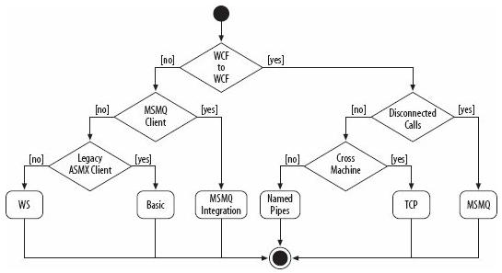
Which Binding To Use?
Image from “Programming WCF Services” by Juval Lowy

Slide 7
Tim’s Rules (SOAP)
Services should take 1 parameter, which should be a DataContract not a .NET type.
This type should be named <Operation>Request
Services should return a DataContract, not a .NET type.
This type should be named <Operation>Response
Choose your operation names carefully, and always assign them namespaces.

Slide 8
What breaks WSDL?
Changing operation name
Changing the number of parameters
Changing the type name of parameter or response
Changing the namespace of operation or types

Slide 9
What does NOT break WSDL?
Adding operations to an existing service
Adding members to an existing data type
Removing non-required members for an existing data type.
Changing URL
This will require re-config of your clients, but will not break proxies.

Slide 10
DEMO
Config via Code

Slide 11
Wait … You don’t use Console apps in production?

Slide 12
DEMO
Hosting in IIS

Slide 13
Inversion of Control

Slide 14
DEMO
Inversion of Control

Slide 15
Get The Source & Slides
https://github.com/trayburn/Presentations.WcfTopics

